Slide 1
NAYA - Project 4
Customer Churn Prediction Model
Olga Soudler, Manor Shpriz
Nov 2024

Slide 2

Overview
Building Customer churn prediction model based on the bank’s customers data set.
The goal is to predict if a customer is planning to leave a bank.

Slide 3

Methodology & Population
Data set contains 10,000 customers
Churn percentage is 20.37%
Training/Test/Validation sizes used – 60%/20%/20%
Data Variables: 6 numeric
2 categorical
2 binary
Testing 5 models: Logistic Regression, K-Nearest Neighbors, Decision Tree, Random Forest and Gradient Boosting algorithms
Gradient Boosting model showed best results better
Generating predictions based on the XGB model

Slide 4
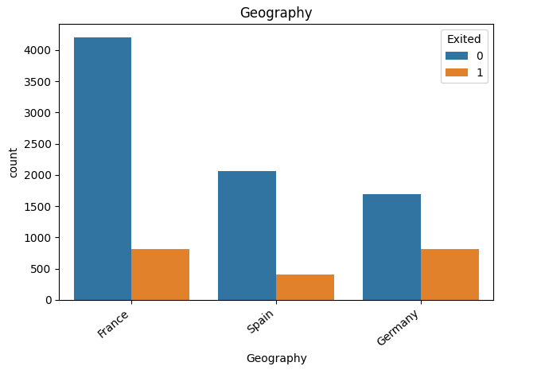
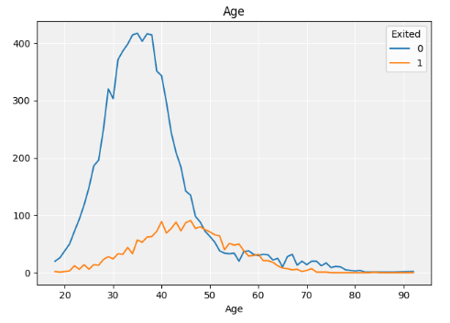
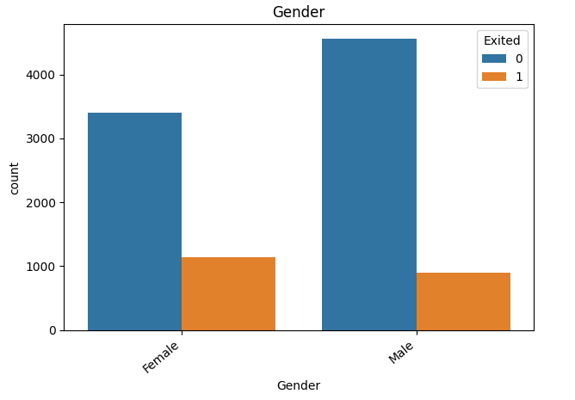
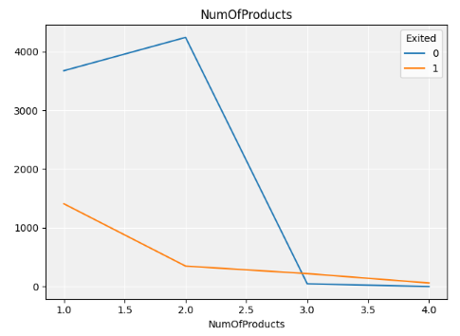
Model - EDA
No unexplainable outliers were present.
No evident interrelationship among the numerical variables.
Product Count: Customers with three or more products exhibit a significantly higher churn rate. Excluding this group could be considered during the modeling process.
Geography: German customers show a distinct churn pattern compared to those from France and Spain.
Gender: Female customers have a higher churn rate than male customers.
Active Membership: Active members tend to have a lower churn rate.
Balance: Accounts with a balance of zero behave differently than those with a positive balance, potentially warranting a separate categorical consideration.
Credit Score: Lower credit scores may correlate with increased churn risk.
Age: Churn rates appear notably higher among customers aged 40 to 60.

Slide 5
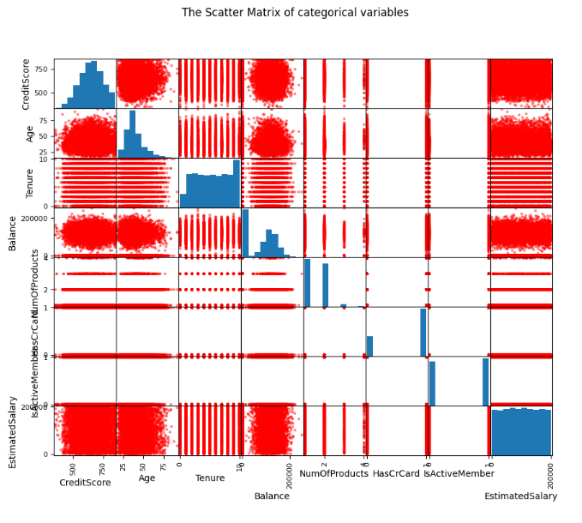
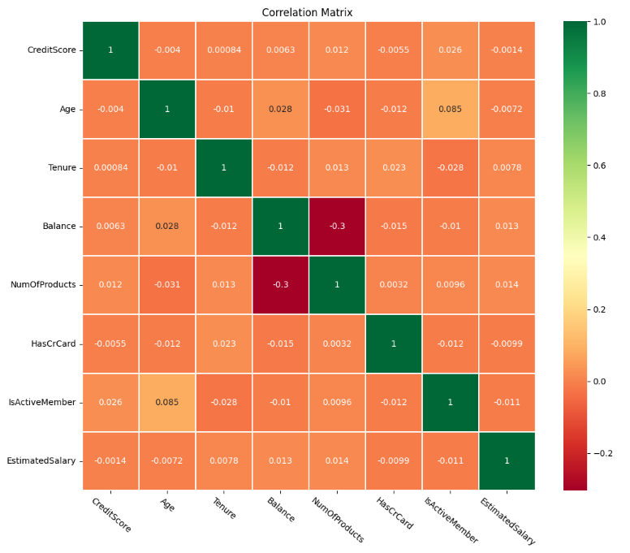
Model - EDA

Slide 6
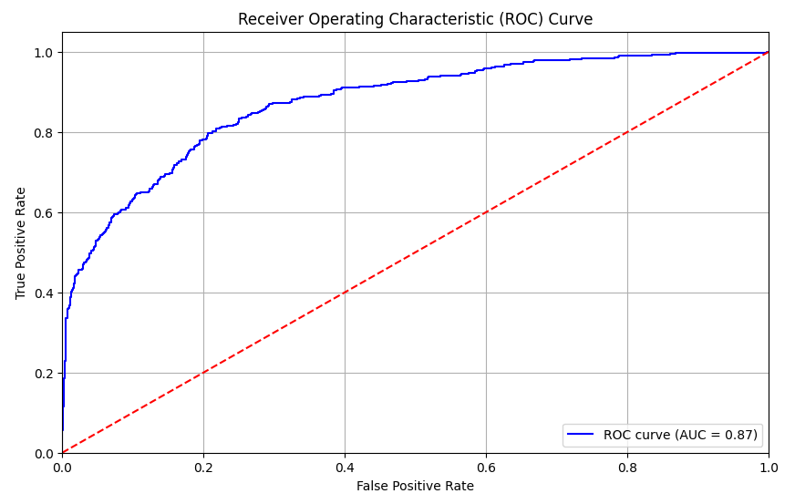
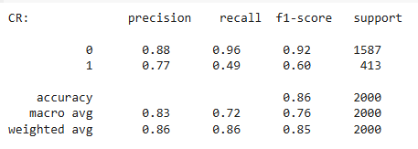
Model - Results – Evaluation Metrics
Accuracy of XGB classifier on training set: 0.86
Accuracy of XGB classifier on test set: 0.86
Accuracy of XGB classifier on validation set: 0.86
Classification Report

Slide 7
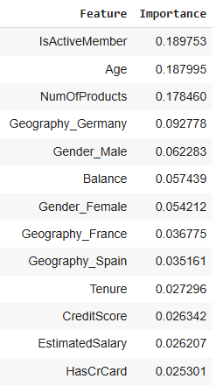
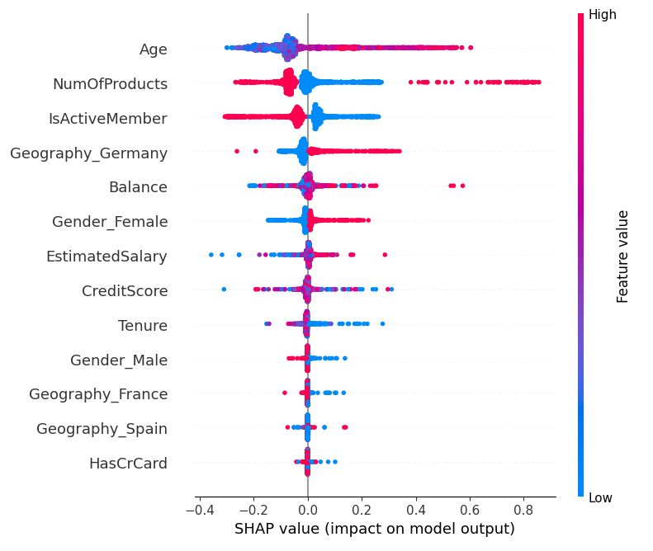
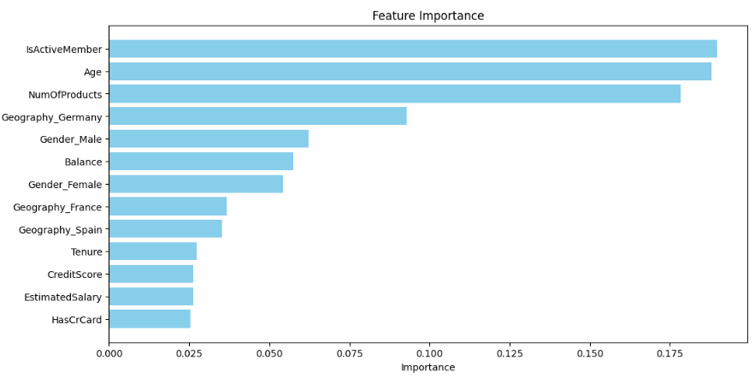
Model Results - Features Importance
Most important features with the highest impact on the prediction are: Age, Number of products, Active Status and Geography Germany with the overall impact of 65% on prediction score.
From the SHAP values chart we can see contribution of each feature on the prediction by its values.
For instance, active member decreases the probability of customers to churn, and German customers are more likely to churn than others.

Slide 8
Model Results - Model Score
Changing TH of the model score from 0.5 to higher value will allow higher precision and lower recall for relevant Probability Ranks. But will decrease an overall PTR.
So, the decision is driven by business goals and purposes.
Model Score TH>=0.5 -> allows to catch ~60% of total Churners with False Rate of 59% targeting 20% of total customers
Model Score TH>=0.5 -> allows to catch ~80% of total Churners with False Rate of 78% targeting 33% of total customers

Slide 9

Next Steps
1
Based on the Score Ranks decide on preferred score TH for the prediction (the current is >=0.5)
2
Building Churn protocol to retain a customers who are likely to churn
3
Building AB Testing and Monitoring the results closely
4
Improvements and changes if needed

Slide 10
Thank you ☺

